Slide 1
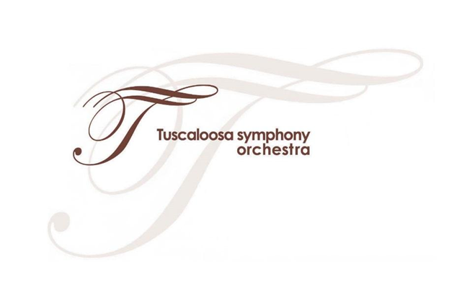
Let’s Meet the People Behind the Show!

Slide 2
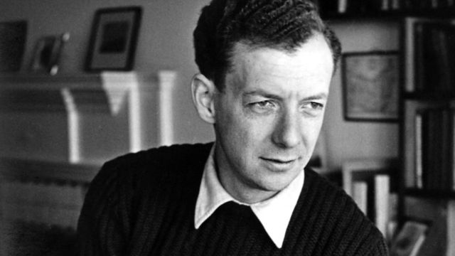
Benjamin Britten

Slide 3
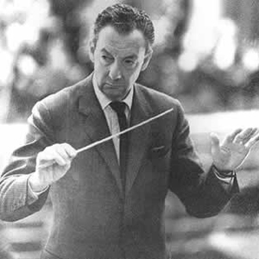
Imagine if you were so well known for your music in your country that you were asked to write music for the Queen of England! Would you feel overwhelmed? Benjamin Britten, an English composer and musician, was that famous during his lifetime, and you will hear his music when you attend the TSO concert.

Slide 4
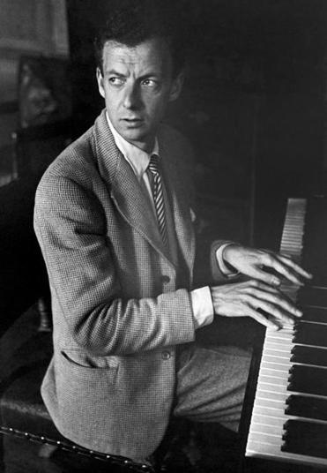
Britten was born on November 22nd, 1913 in Lowestoft, England, a small fishing town, and was the youngest of four children. From a young age, he showed a talent for music. His mother thought he was destined for greatness as a composer, and believed that he would be as well-known as Beethoven one day!

Slide 5
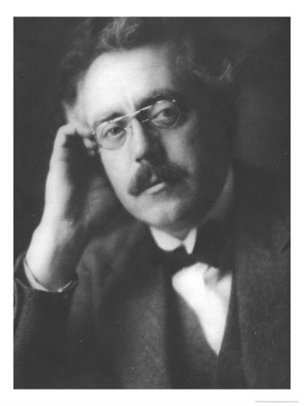
Britten first tried composing music when he was five years old, but did not learn to play an instrument until he was seven, when he started taking piano lessons. Then, at age ten, he learned to play the viola. As a teenager, he learned to write music from Frank Bridge (pictured), a well-known composer. Later, he studied at the Royal College of Music in London. While there, he composed his first major pieces.

Slide 6
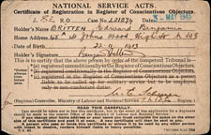
Britten was a pacifist, meaning he was against all wars for any reason. Because of this, he was an outcast in his native England when World War II broke out. In 1939, he moved to the U.S., where the war had not yet begun. This paper is what he had to sign saying he was officially against the war, and which gave him permission to leave.

Slide 7
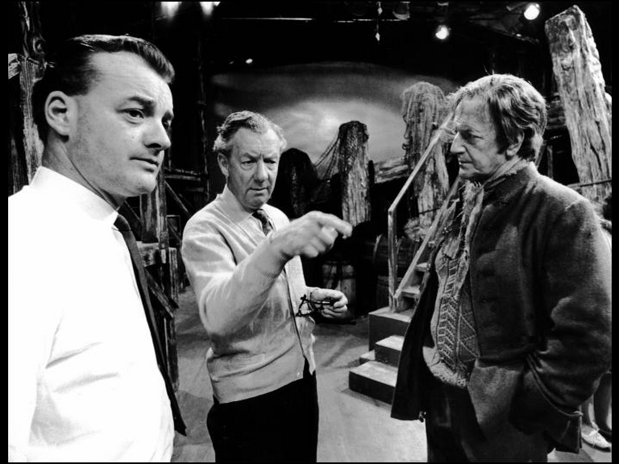
Britten became homesick in America. While there, he wrote one of his most famous pieces, Peter Grimes, an opera that takes place in a small English fishing town like the one in which he grew up. He moved back to England in 1942, and Peter Grimes premiered there. Here he is on the set of the opera.

Slide 8
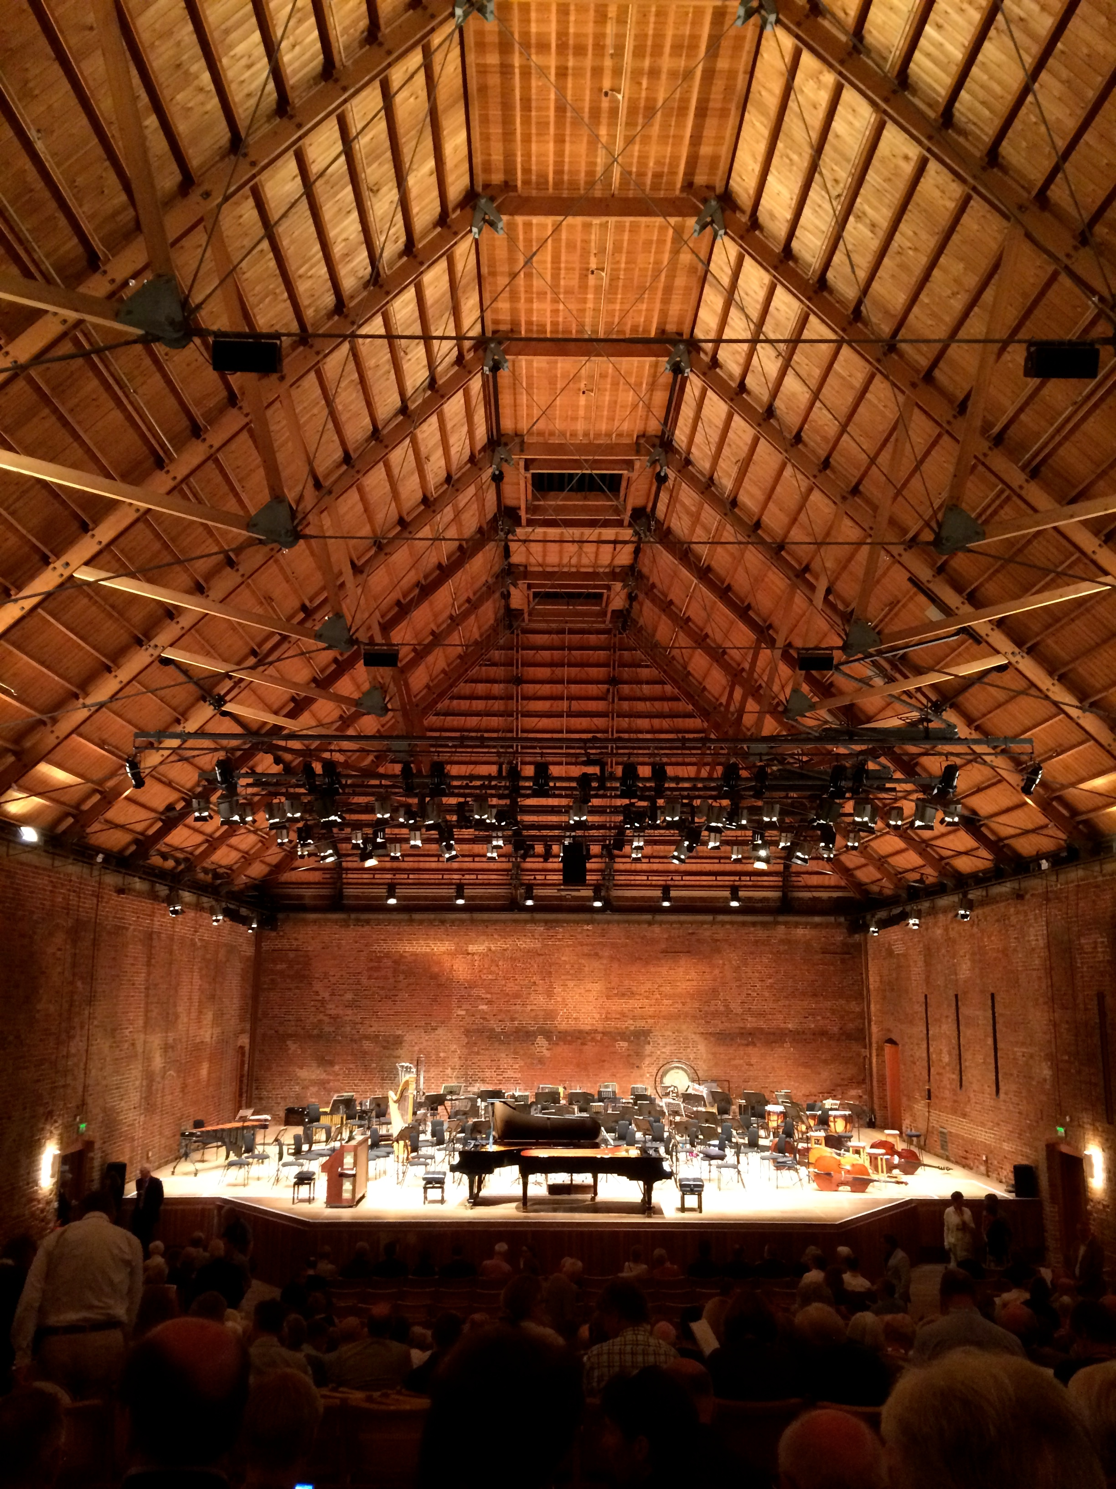
Peter Grimes was very successful and made Britten famous in England. For the rest of his life, he was asked to write music for big occasions, like the crowning of the new Queen of England! He was also able to start a big music festival that still happens every summer near his hometown. He even designed his own opera house, pictured here!

Slide 9
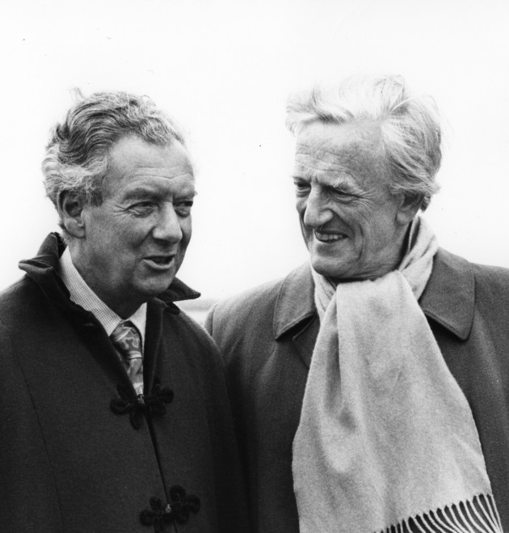
Britten lived the rest of his life as a successful composer and conductor in England, but his music was and still is played around the world. He even wrote an opera for TV! Even after he became very sick with heart disease, he continued to write music. Britten died in England on December 4th, 1976.

Slide 10
Before we explore Britten’s A Young Person’s Guide to the Orchestra, we will first listen to another one of his pieces in order to understand what his music sounds like. This piece is from his famous opera, Peter Grimes, and is part of a group of pieces called “Four Sea Interludes.”
While listening, think about what the music represents. What is the weather like? Can you hear the ocean? What instruments do you hear?

Slide 11
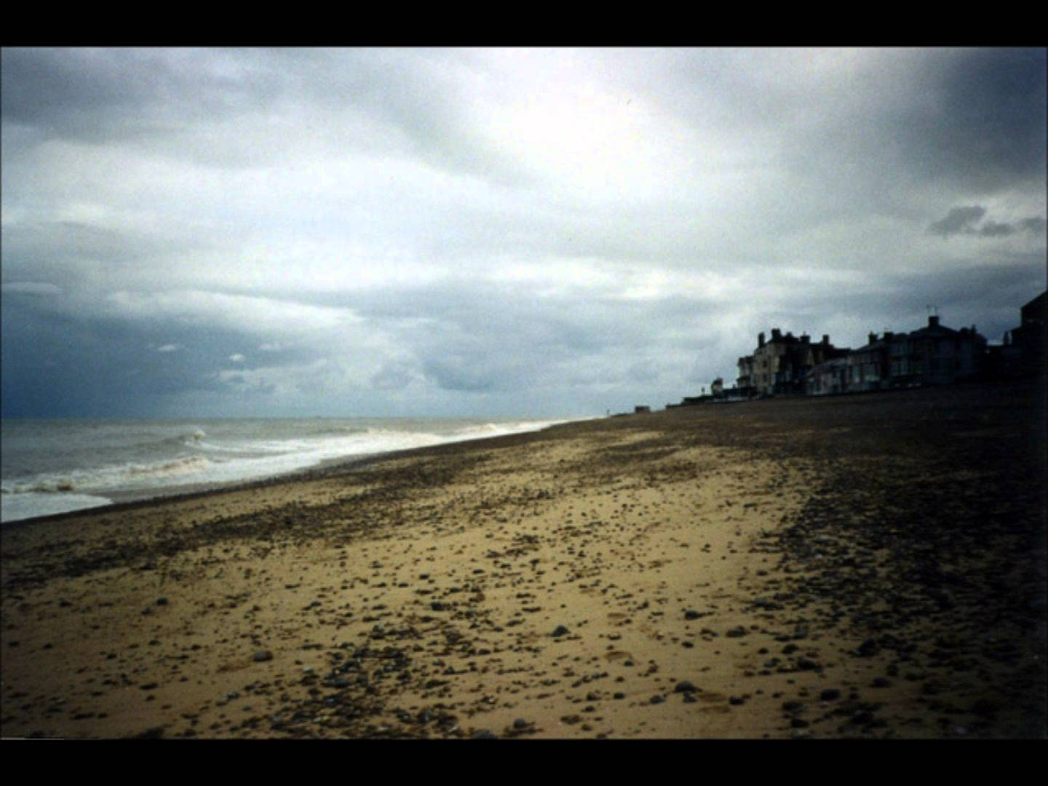
https://www.youtube.com/watch?v=2X7JDvTarqQ

Slide 12
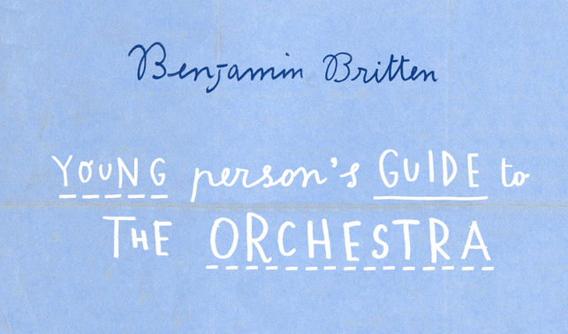
Britten composed A Young Person’s Guide to the Orchestra in 1945, and, like Peter Grimes, it is one of his most famous pieces of music. You will hear the TSO play it when you attend the performance. A Young Person’s Guide is a type of music called a “Theme and Variations.” Let’s learn about this!

Slide 13
A “Theme and Variations” is a type of music that starts with a simple musical theme – a melody that you can hum along to – and uses the theme to make new melodies.
Sometimes, the new music turns the theme backwards, is softer or louder than the theme, or uses different instruments than the theme. It is sort of like putting a set of blocks on a table, and then moving them around and rearranging them in different ways.

Slide 14
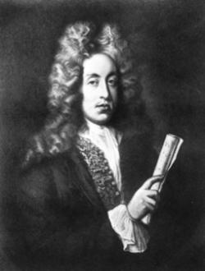
The theme Britten uses in A Young Person’s Guide to the Orchestra was actually written by a different composer named Henry Purcell. Purcell was alive in the 1600s – well before Britten lived and worked – but, like Britten, was very famous and well known for his operas. Let’s listen to the theme now!

Slide 15
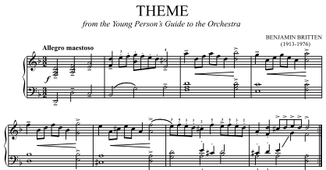
https://www.youtube.com/watch?v=QNOTFuGhQgc

Slide 16
When you attend the TSO concert, you will hear how Benjamin Britten rearranges this theme in many different ways!

Slide 17
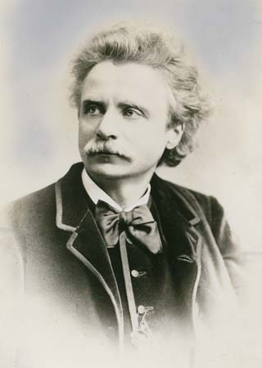
Edvard Grieg

Slide 18
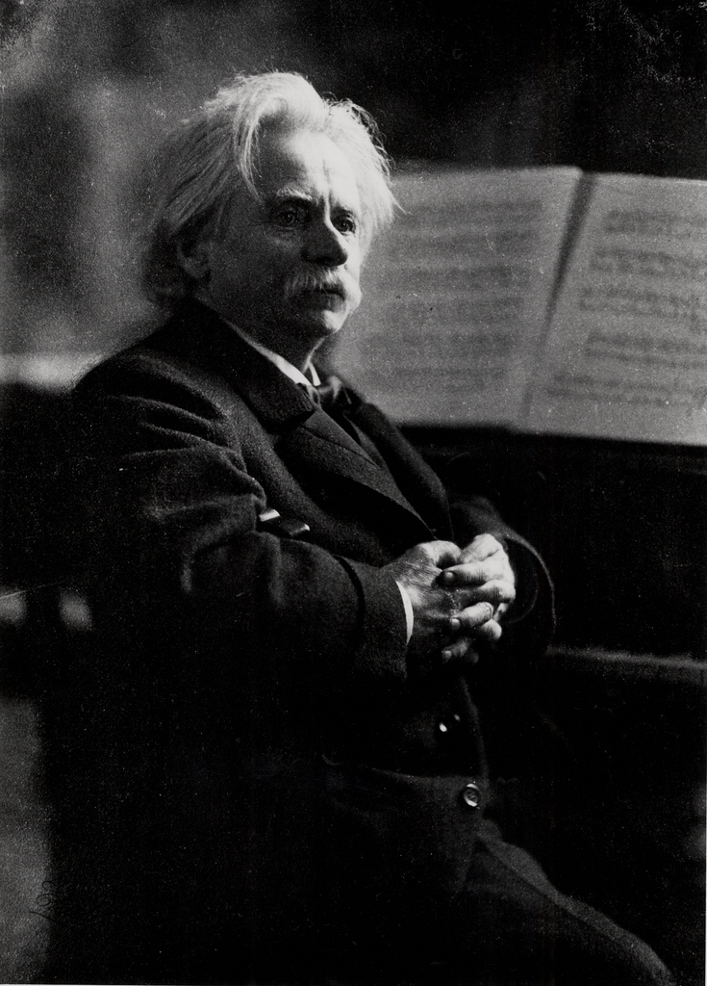
Edvard Grieg was a composer from Norway who lived from 1843 to 1907. His main instrument was the piano, and he often used folk music from his country as inspiration for his music. One of his most famous pieces is the Peer Gynt Suite. You will hear a selection from this music, called “In the Hall of the Mountain King,” at the TSO concert!

Slide 19
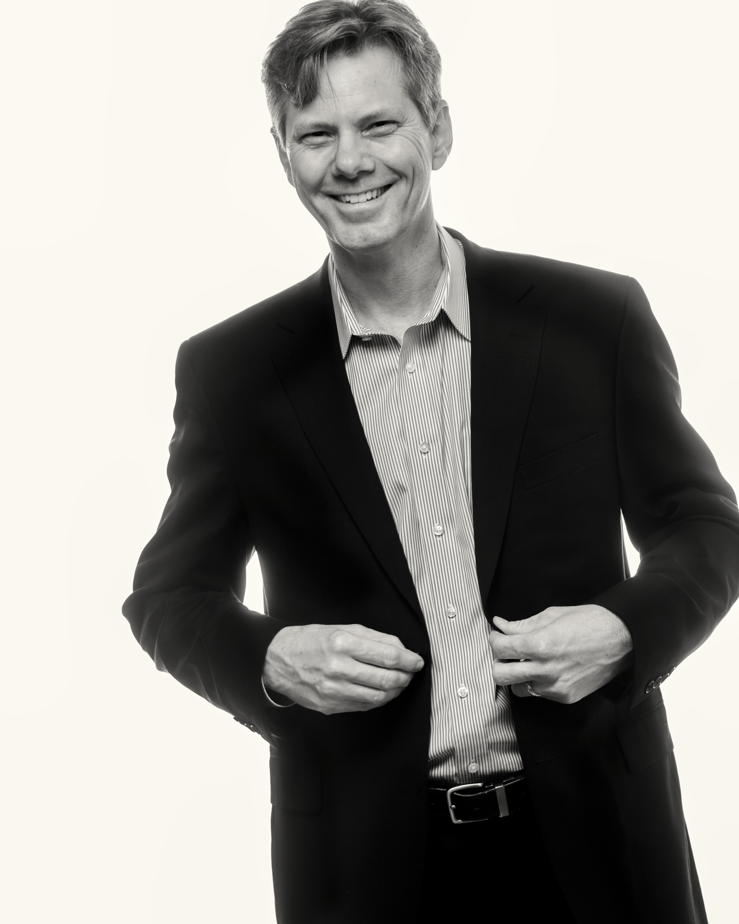
Adam Flatt

Slide 20
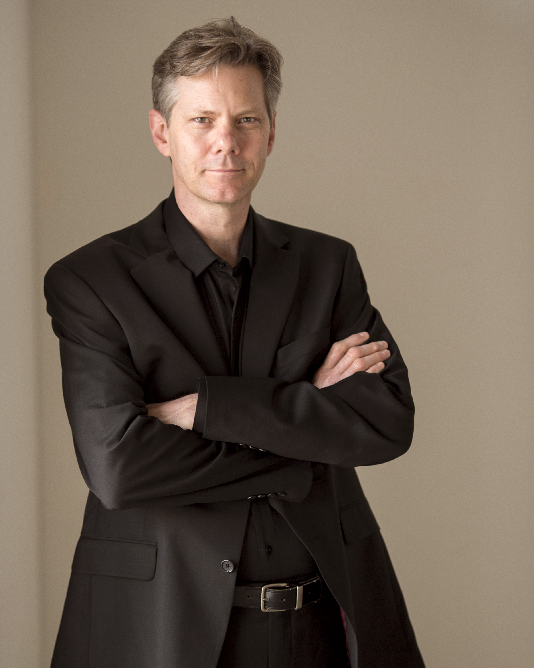
Adam Flatt is the music director and conductor of the Tuscaloosa Symphony. He is from California and now lives in Colorado. His job is to lead the orchestra and choose the music it plays. He has conducted all over the U.S. and the world. You will meet him at the concert!

Slide 21
David Duff

Slide 22
David Duff will be the narrator at the Tuscaloosa Symphony concert, and will guide you through the music. He has lived in Alabama for most of his life, and currently is the Music Director for Alabama Public Radio. If you tune into this station, you will often hear his voice! He also plays the piano. You will meet him at the concert!

Slide 23
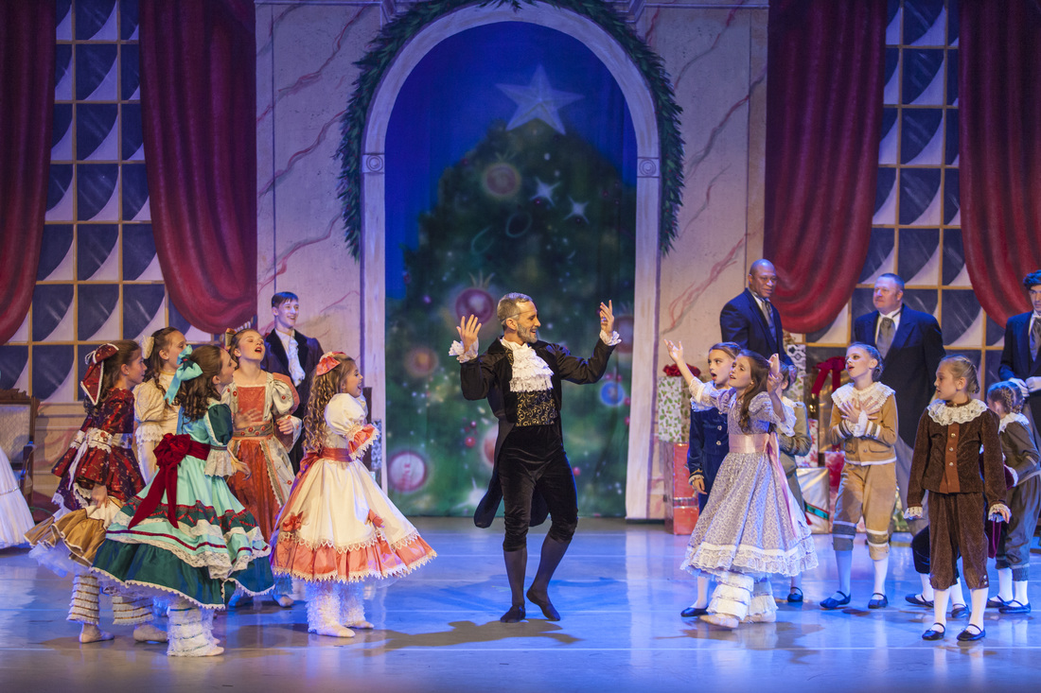
Tuscaloosa Community Dancers

Slide 24
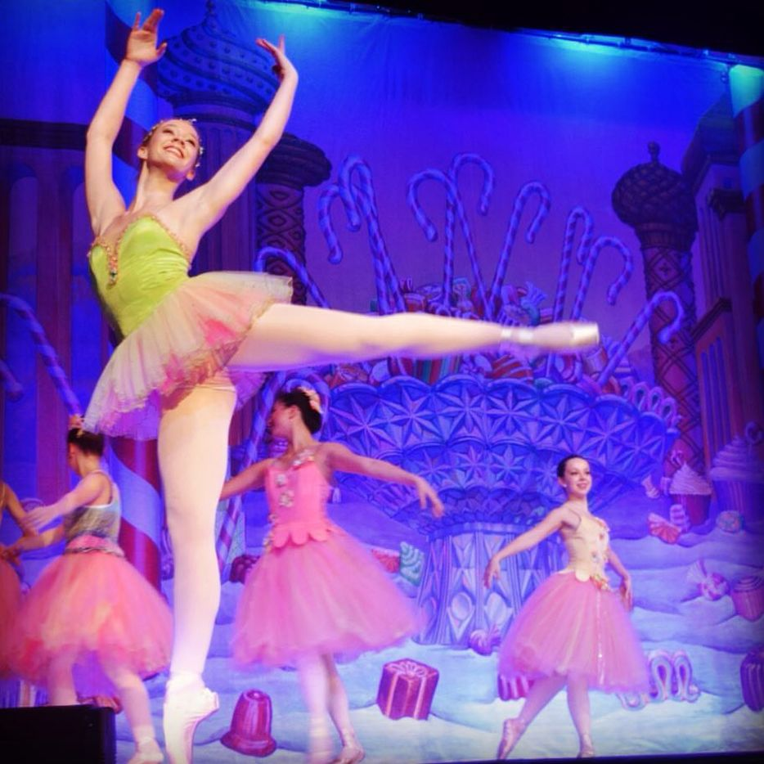
The Tuscaloosa Community Dancers is a dance company that began in 1971. The dancers are mostly known for ballet performances, and collaborate with music groups like the Tuscaloosa Symphony. You will see some of the ballet dancers bring the music to life at the concert!

Slide 25
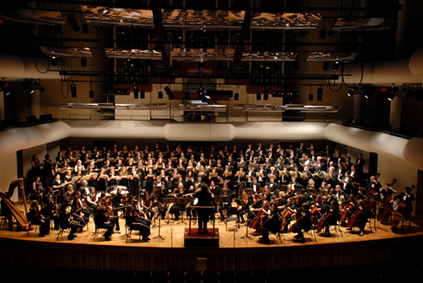
Tuscaloosa Symphony Orchestra
.

Slide 26
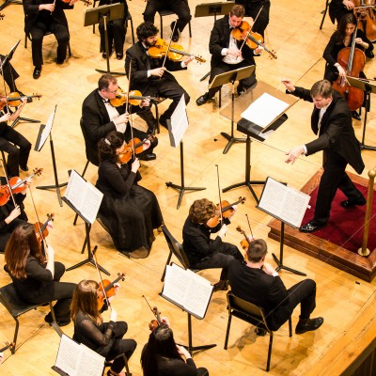
The Tuscaloosa Symphony Orchestra is made up of professional musicians. Being a professional musician takes a lot of practice and dedication. Most members of the TSO have been playing their instruments for 15 years or more.
Members of the TSO have to audition in order to play in the orchestra. Only highly-trained musicians are given the opportunity to join the orchestra.
Some musicians in the TSO come from far away to play for you! Many of the musicians come from Birmingham, AL, Nashville, TN, New Orleans, LA, and Atlanta, GA, but many live in Tuscaloosa.

